Slide 1

DATA WAREHOUSE
Data Warehouse for Business Intelligent
Pengetahuan
Informasi
Data
Arsitektur Data Warehouse
About Me
Dosen Pengampu: Joko Suntoro, M.Kom.

Slide 2
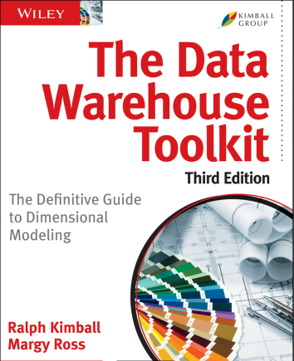
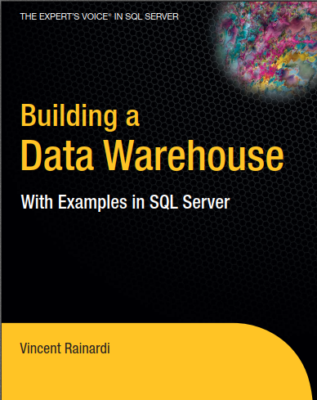

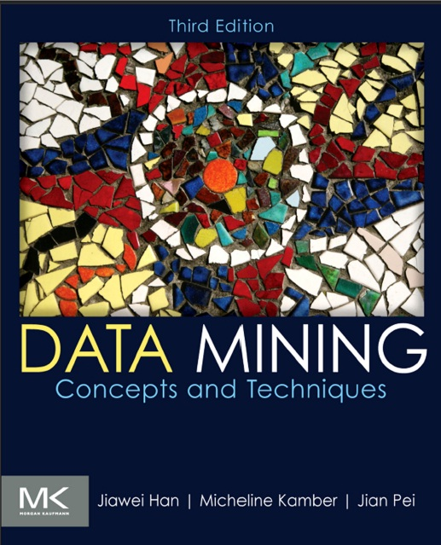
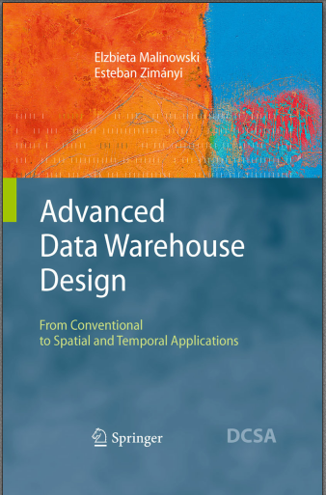
Textbooks
Pengetahuan
Informasi
Data
Arsitektur Data Warehouse
About Me

Slide 3








Joko Suntoro, M.Kom.
Pengetahuan
Informasi
Data
Arsitektur Data Warehouse
About Me
Peneliti Intelligent Systems Research Group
(Romi Satria Wahono, Ph.D.)
Dosen Teknik Informatika
Universitas Semarang
085-641-970-170
jokosuntoro@usm.ac.id
0822-4236-9670

Slide 4
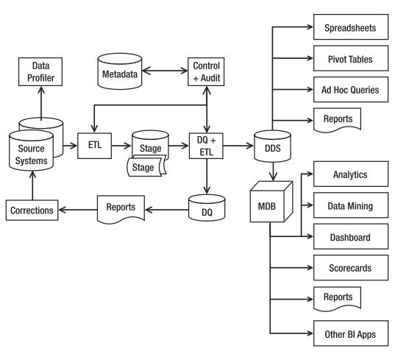
Diagram Data Warehouse
Pengetahuan
Informasi
Data
Arsitektur Data Warehouse
About Me

Slide 5
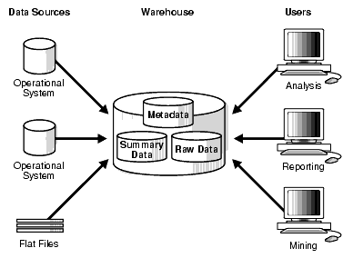
Arsitektur Dasar
Pengetahuan
Informasi
Data
Arsitektur Data Warehouse
About Me

Slide 6
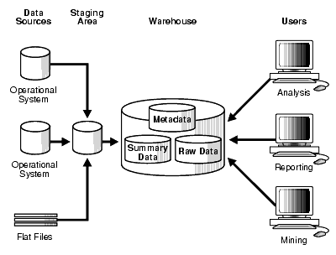
Arsitektur Staging Area
Pengetahuan
Informasi
Data
Arsitektur Data Warehouse
About Me

Slide 7
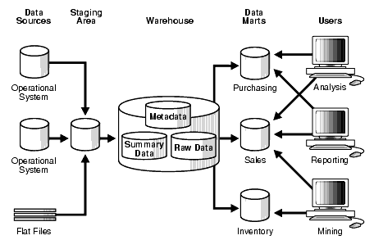
Arsitektur Staging Area + Data Mart
Pengetahuan
Informasi
Data
Arsitektur Data Warehouse
About Me

Slide 8
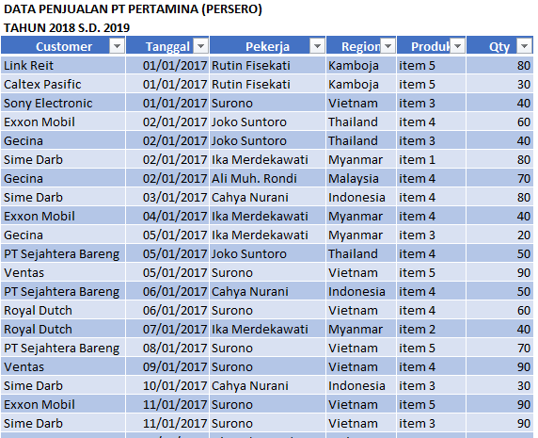
Data
Pengetahuan
Informasi
Data
Arsitektur Data Warehouse
About Me

Slide 9
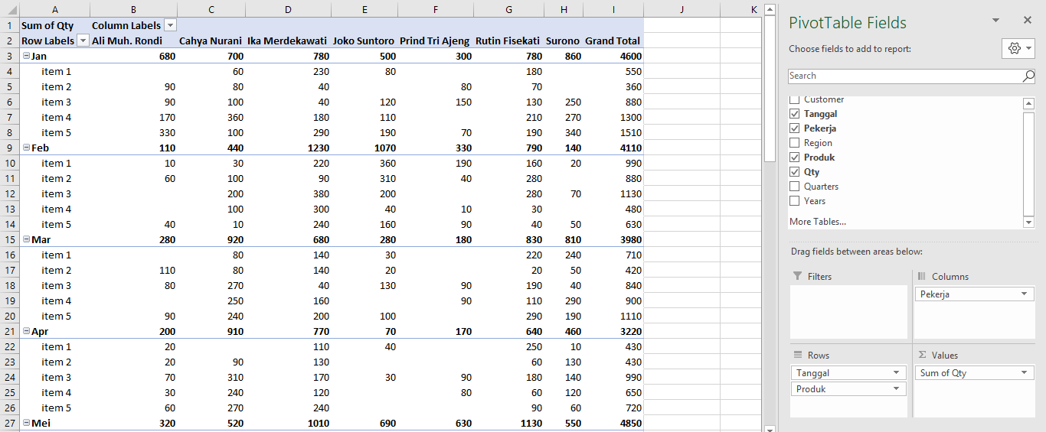
Informasi
Pivot Table
Pengetahuan
Informasi
Data
Arsitektur Data Warehouse
About Me

Slide 10
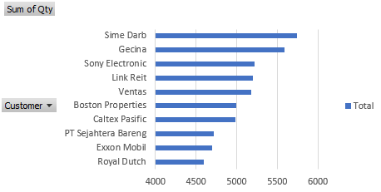
Informasi
Pivot Chart
Pengetahuan
Informasi
Data
Arsitektur Data Warehouse
About Me

Slide 11
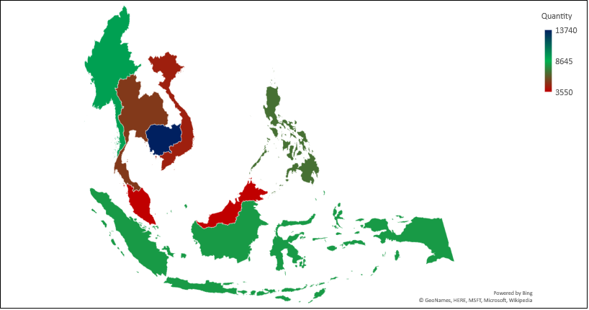
Informasi
Map Chart
Pengetahuan
Informasi
Data
Arsitektur Data Warehouse
About Me

Slide 12
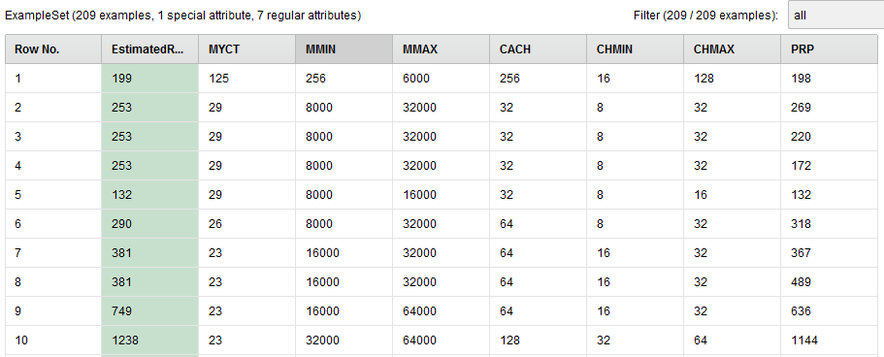
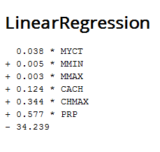
Pengetahuan
Formula Matematika
Pengetahuan
Informasi
Data
Arsitektur Data Warehouse
About Me
ERP=0,038*MYCT+0,005*MMIN+0,003*MMAX+0,124*CACH+0,344*CHMAX+0,577*PRP-34,239

Slide 13
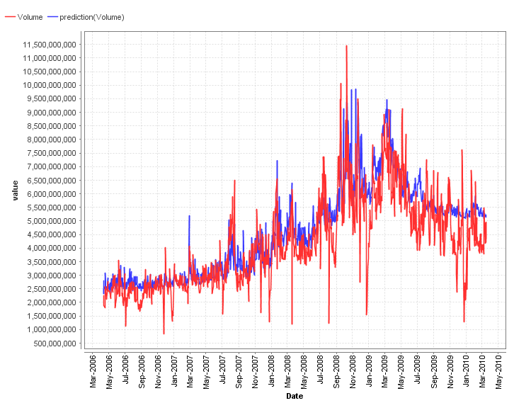
Pengetahuan
Grafik (Prediksi)
Pengetahuan
Informasi
Data
Arsitektur Data Warehouse
About Me

Slide 14
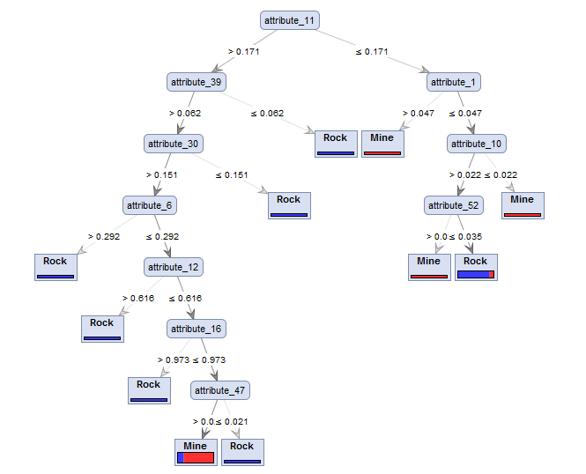
Pengetahuan
Pohon Keputusan
Pengetahuan
Informasi
Data
Arsitektur Data Warehouse
About Me

Slide 15
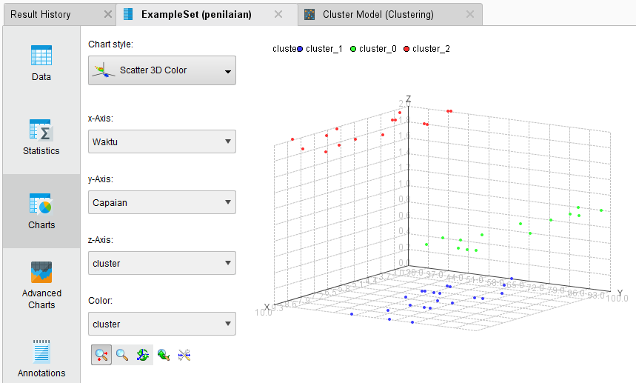
Pengetahuan
Pengelompokan Data
Pengetahuan
Informasi
Data
Arsitektur Data Warehouse
About Me

Slide 16
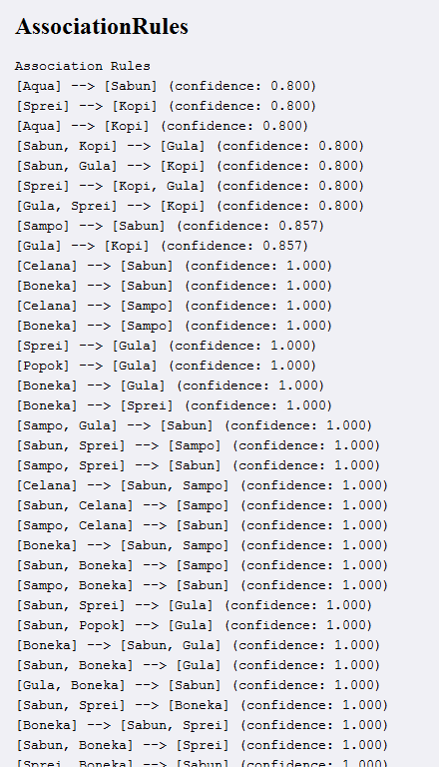
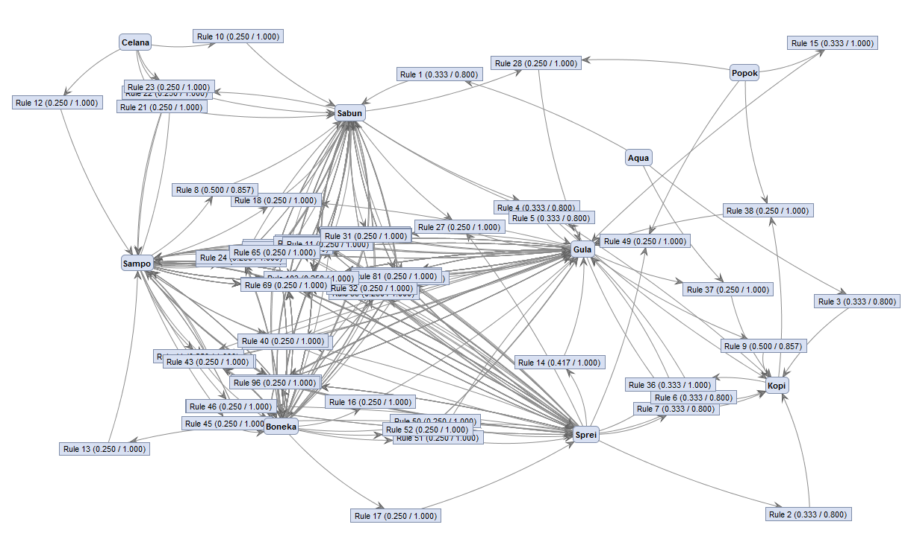
Pengetahuan
Association Rules
Pengetahuan
Informasi
Data
Arsitektur Data Warehouse
About Me

Slide 17
Referensi
Bache, K., & Lichman, M. (2013). UCI Machine Learning Repository. Retrieved from http://www.ics.uci.edu/~mlearn/MLRepository.html
Hofmann, M., & Klinkenberg, R. (2013). Rapid Miner Data Mining Use Cases and Business Analytics Applications. CRC Press Taylor & Francis Group
Ian H. Witten, Frank Eibe, Mark A. Hall. Data mining: Practical Machine Learning Tools and Techniques 3rd Edition. Elsevier. 2011
Jiawei Han and Micheline Kamber. Data Mining: Concepts and Techniques Third Edition. Elsevier. 2012
Kimball, R., & Ross, M. (2013). The Data Warehouse Toolkit. Willey Publishing, Inc.
Lantz, Brett. Machine Learning with R. Packt Publishing. 2013
Larose, D. T. (2006). Data Mining Methods and Models. Data Mining Methods and Models. Canada: Willey Publishing, Inc.
Malinowski, E., & Zimany, E. (2011). Advanced Data Warehouse Design. Germany: Springer Berlin Heidelberg.
Noth, Matthew. Data Mining for The Masses. Creative Commons Attribution. 2012
Rainardi, V. (2008). Building a Data Warehouse With Examples in SQL Server. Apress.
Shahbaz, Q. (2016). Data Mapping for Data Warehouse Design. Elsevier Inc.
Staging Area + Data Mart
Staging Area
Arsitektur Dasar
Jenis DWA
Definisi DWA
About Me

